Slide 1
AWSTemplateFormatVersion: '2010-09-09'
Metadata:
License: Apache-2.0
Parameters:
HashKeyElementName:
Description: HashType PrimaryKey Name
Type: String
AllowedPattern: '[a-zA-Z0-9]*'
MinLength: '1'
MaxLength: '2048'
ConstraintDescription: must contain only alphanumberic characters
HashKeyElementType:
Description: HashType PrimaryKey Type
Type: String
Default: S
AllowedPattern: '[S|N]'
MinLength: '1'
MaxLength: '1'
ConstraintDescription: must be either S or N
ReadCapacityUnits:
Description: Provisioned read throughput
Type: Number
Default: '5'
MinValue: '5'
MaxValue: '10000'
ConstraintDescription: must be between 5 and 10000
WriteCapacityUnits:
Description: Provisioned write throughput
Type: Number
Default: '10'
MinValue: '5'
MaxValue: '10000'
ConstraintDescription: must be between 5 and 10000
Resources:
myDynamoDBTable:
Type: AWS::DynamoDB::Table
Properties:
AttributeDefinitions:
- AttributeName: !Ref 'HashKeyElementName'
AttributeType: !Ref 'HashKeyElementType'
KeySchema:
- AttributeName: !Ref 'HashKeyElementName'
KeyType: HASH
ProvisionedThroughput:
ReadCapacityUnits: !Ref 'ReadCapacityUnits'
WriteCapacityUnits: !Ref 'WriteCapacityUnits'
Outputs:
TableName:
Value: !Ref 'myDynamoDBTable'
Description: Table name of the newly created DynamoDB table
Resources:
TableOfBooks:
Type: AWS::DynamoDB::Table
Properties:
AttributeDefinitions:
- AttributeName: Title
AttributeType: S
- AttributeName: Category
AttributeType: S
- AttributeName: Language
AttributeType: S
KeySchema:
- AttributeName: Category
KeyType: HASH
- AttributeName: Title
KeyType: RANGE
ProvisionedThroughput:
ReadCapacityUnits: !Ref 'ReadCapacityUnits'
WriteCapacityUnits: !Ref 'WriteCapacityUnits'
LocalSecondaryIndexes:
- IndexName: LanguageIndex
KeySchema:
- AttributeName: Category
KeyType: HASH
- AttributeName: Language
KeyType: RANGE
Projection:
ProjectionType: KEYS_ONLY
GlobalSecondaryIndexes:
- IndexName: TitleIndex
KeySchema:
- AttributeName: Title
KeyType: HASH
Projection:
ProjectionType: KEYS_ONLY
ProvisionedThroughput:
ReadCapacityUnits: !Ref 'ReadCapacityUnits'
WriteCapacityUnits: !Ref 'WriteCapacityUnits'
Outputs:
TableName:
Value: !Ref 'TableOfBooks'
Description: Name of the newly created DynamoDB table
# The task definition. This is a simple metadata description of what
# container to run, and what resource requirements it has.
TaskDefinition:
Type: AWS::ECS::TaskDefinition
Properties:
Family: !Ref 'ServiceName'
Cpu: !Ref 'ContainerCpu'
Memory: !Ref 'ContainerMemory'
NetworkMode: awsvpc
RequiresCompatibilities:
- FARGATE
ExecutionRoleArn:
Fn::ImportValue:
!Join [':', [!Ref 'StackName', 'ECSTaskExecutionRole']]
TaskRoleArn:
Fn::If:
- 'HasCustomRole'
- !Ref 'Role'
- !Ref "AWS::NoValue"
ContainerDefinitions:
- Name: !Ref 'ServiceName'
Cpu: !Ref 'ContainerCpu'
Memory: !Ref 'ContainerMemory'
Image: !Ref 'ImageUrl'
PortMappings:
- ContainerPort: !Ref 'ContainerPort'
# The service. The service is a resource which allows you to run multiple
# copies of a type of task, and gather up their logs and metrics, as well
# as monitor the number of running tasks and replace any that have crashed
Service:
Type: AWS::ECS::Service
DependsOn: LoadBalancerRule
Properties:
ServiceName: !Ref 'ServiceName'
Cluster:
Fn::ImportValue:
!Join [':', [!Ref 'StackName', 'ClusterName']]
LaunchType: FARGATE
DeploymentConfiguration:
MaximumPercent: 200
MinimumHealthyPercent: 75
DesiredCount: !Ref 'DesiredCount'
NetworkConfiguration:
AwsvpcConfiguration:
AssignPublicIp: ENABLED
SecurityGroups:
- Fn::ImportValue:
!Join [':', [!Ref 'StackName', 'FargateContainerSecurityGroup']]
Subnets:
- Fn::ImportValue:
!Join [':', [!Ref 'StackName', 'PublicSubnetOne']]
- Fn::ImportValue:
!Join [':', [!Ref 'StackName', 'PublicSubnetTwo']]
TaskDefinition: !Ref 'TaskDefinition'
LoadBalancers:
- ContainerName: !Ref 'ServiceName'
ContainerPort: !Ref 'ContainerPort'
TargetGroupArn: !Ref 'TargetGroup'
# A target group. This is used for keeping track of all the tasks, and
# what IP addresses / port numbers they have. You can query it yourself,
# to use the addresses yourself, but most often this target group is just
# connected to an application load balancer, or network load balancer, so
# it can automatically distribute traffic across all the targets.
TargetGroup:
Type: AWS::ElasticLoadBalancingV2::TargetGroup
Properties:
HealthCheckIntervalSeconds: 6
HealthCheckPath: /
HealthCheckProtocol: HTTP
HealthCheckTimeoutSeconds: 5
HealthyThresholdCount: 2
TargetType: ip
Name: !Ref 'ServiceName'
Port: !Ref 'ContainerPort'
Protocol: HTTP
UnhealthyThresholdCount: 2
VpcId:
Fn::ImportValue:
!Join [':', [!Ref 'StackName', 'VPCId']]
# Create a rule on the load balancer for routing traffic to the target group
LoadBalancerRule:
Type: AWS::ElasticLoadBalancingV2::ListenerRule
Properties:
Actions:
- TargetGroupArn: !Ref 'TargetGroup'
Type: 'forward'
Conditions:
- Field: path-pattern
Values: [!Ref 'Path']
ListenerArn:
Fn::ImportValue:
!Join [':', [!Ref 'StackName', 'PublicListener']]
Priority: !Ref 'Priority'
Infrastructure
as Code

Slide 2
I need a MySQL database and a load balancer for my application in production

Slide 3
I’m installing MySQL, looks good, right?
$ ssh ec2-user@10.180.18.171
The authenticity of host '10.180.18.171 (10.180.18.171)' can't be established.
ECDSA key fingerprint is SHA256:T/JmW5xqkVdhZxHO37LsNxtb8KHFN6FxSqazY3ibaIU.
ECDSA key fingerprint is MD5:d1:70:5a:1a:28:82:fe:32:ac:1c:b4:28:f9:e2:5d:5c.
Are you sure you want to continue connecting (yes/no)? yes
Warning: Permanently added '10.180.18.171' (ECDSA) to the list of known hosts.
__| __| __|
_| ( \__ \ Amazon Linux 2 (ECS Optimized)
____|\___|____/
For documentation, visit http://aws.amazon.com/documentation/ecs
[ec2-user@ip-10-180-18-171 ~]$ sudo apt-get install mysql-server
Reading package lists... Done
Building dependency tree
Reading state information... Done
The following additional packages will be installed:
libaio1 libcgi-fast-perl libcgi-pm-perl libedit2 libencode-locale-perl libevent-core-2.1-6 libfcgi-perl libgdbm-compat4 libgdbm5 libhtml-parser-perl libhtml-tagset-perl libhtml-template-perl libhttp-date-perl libhttp-message-perl libio-html-perl liblwp-mediatypes-perl
libnuma1 libperl5.26 libtimedate-perl liburi-perl libwrap0 mysql-client-5.7 mysql-client-core-5.7 mysql-common mysql-server-5.7 mysql-server-core-5.7 netbase perl perl-modules-5.26 psmisc
Suggested packages:
gdbm-l10n libdata-dump-perl libipc-sharedcache-perl libwww-perl mailx tinyca perl-doc libterm-readline-gnu-perl | libterm-readline-perl-perl make
The following NEW packages will be installed:
libaio1 libcgi-fast-perl libcgi-pm-perl libedit2 libencode-locale-perl libevent-core-2.1-6 libfcgi-perl libgdbm-compat4 libgdbm5 libhtml-parser-perl libhtml-tagset-perl libhtml-template-perl libhttp-date-perl libhttp-message-perl libio-html-perl liblwp-mediatypes-perl
libnuma1 libperl5.26 libtimedate-perl liburi-perl libwrap0 mysql-client-5.7 mysql-client-core-5.7 mysql-common mysql-server mysql-server-5.7 mysql-server-core-5.7 netbase perl perl-modules-5.26 psmisc
0 upgraded, 31 newly installed, 0 to remove and 9 not upgraded.
Need to get 27.8 MB of archives.
After this operation, 204 MB of additional disk space will be used.
Do you want to continue? [Y/n] Y
Get:1 http://archive.ubuntu.com/ubuntu bionic/main amd64 mysql-common all 5.8+1.0.4 [7308 B]

Slide 4
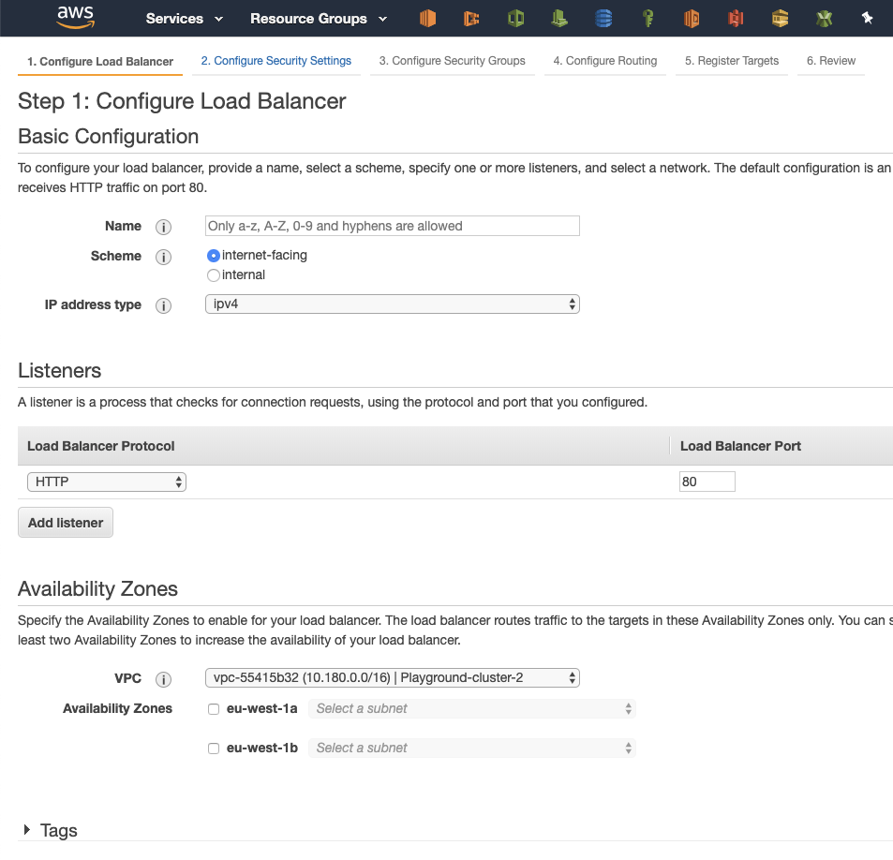
I’m creating the load balancer, following best practices, or?

Slide 6
Snowflakes
Unique
Can’t be reproduced
Can’t be automated
Expensive to set up
Expensive to maintain
No (or little) traceability

Slide 7
What do we want then?
We want recipes for all our infrastructure
We want the recipes to be under version control
We want to automatize the application of the recipes

Slide 8
We want infrastructure as code

